Slide 1

Data Analytics
Accenture Virtual Program
Notes:
Good morning, everyone. My name is Pratikgiri. Today, I am going to share the process and insights obtained from our data analytics task for the Social Buzz.

Slide 2

Agenda
Project Recap
Problem
Team
Process
Insights
Summary
Notes:
The agenda for today’s presentation is as shown here:
First, we will understand the overview of the business problem that we are tackling and the client’s requirements.
Then, we will look at the problem the data analytics team is focusing on.
Next, I will introduce to the team members.
After that, I will walk you through the process followed to complete the task.
Then, I will present the insights with different visualizations.
Finally, I will conclude the presentation with the summary of the task performed.

Slide 3

Project Recap
Social Buzz
Fast growing technology unicorn
Adapt quickly to global scale
Audit of Big Data Practices
Recommendations for a successful IPO
Analysis to find the top 5 most popular content categories
Notes:
The company has become a fast growing tech unicorn in recent years. To help them adapt quickly to global scale, we are here to assist the company to tackle this huge scale.
This needs several tasks. First is auditing Big Data Practices and providing feedback and solutions for the same. Next, our team will be guiding you for a launch of successful IPO.
Finally, the task that our team has performed specifically. That is, analysis on your data to find insights and top 5 most popular content categories.

Slide 4

Problem
Over 10000 posts per day!
36500000 pieces of content per year!
Highly unstructured data
Capitalize on it
Analysis: insights!
Notes:
Here is the specific problem that our data analytics team has worked on. As ,mentioned earlier, the company is dealing with over 10000 posts per day, in turn, 36500000 pieces of content in a year. This data is not only huge but also highly unstructured. Indeed, it is quite a complex task to deal with; however, data is the master key of the business. Getting useful insights from the huge content is the key to capitalize. We are here to offer our expertise to dig into the data and find useful information for the company.

Slide 5


Analytics Team
Andrew Fleming
Chief Technology Architect
Marcus Rompton
Senior Principal
Pratik Goswami
Data Analyst
Notes:
When I say ‘our expertise’, I mean it owing to the experienced experts of our data analytics tram at Accenture. For this specific task, we are a team of 3 members. Andrew Fleming is Chief Technology Architect who is offering his expertise to ensure high quality insights and suggest a solid data strategy. Marcus Rompton is Senior Principal and he is expert in media and content industry. He manages the data analysis and results of our tasks. I am the data analyst and responsible for performing hands-on data analysis to translate business requirements into useful insights.

Slide 6

Process
Data Understanding
Data Cleaning
Data Modelling
Data Analysis
Uncover Insights
Notes:
The process we have followed for the assigned task as shown. First, we understood the overview of the business and narrowed down the requirements. Based on the needs, we accessed the data and got information about all the fields present in the data. From that, we cleaned the data to remove unnecessary fields, erroneous and missing data. These two tasks of cleaning and modelling were performed in MySQL. Then we modelled the cleaned data with the fields required for our data analysis job. Upon having the right dataset, we performed data analysis tasks to produce meaningful visualizations so that we can uncover insights to solve the business problem.

Slide 7

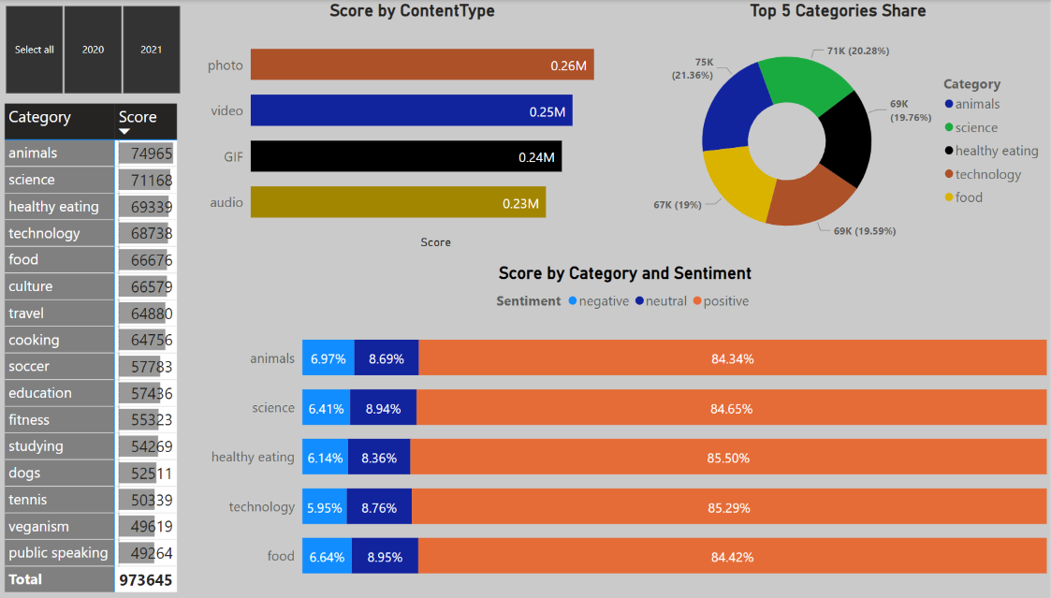
Analysis & Insights
Notes:
I have created all the visualizations using Power BI dashboard so that it can be more understandable and interactive for the future use with dynamic visualizations. It can be seen that there are total 16 categories of the content listed on the left pane. It includes animals, science, technology and many more. In the sample dataset of years 2020 and 2021, all time analysis says that there were total 973645 posts in the given timeline. Among all the posts, the top 5 categories are animals, science, healthy eating, technology and food. Talking about the type of content posted, photos and videos occupy the most share compared to GIFs and audios. This visualization is important as it is related to the size of the content posted. Talking about the reactions, the top 5 categories have mostly positive reactions, that is over 84%. It depicts that these top 5 categories are not only the posts with most reactions but also with positive feedback meaning that users love the posts related to these categories.

Slide 8
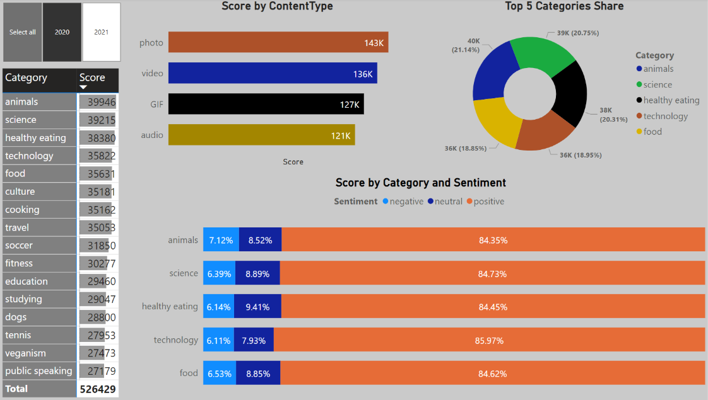
Analysis & Insights
Notes:
Now let’s look into specifically the year 2020. The top 5 categories in 2020 were the same as that of all time. However, the difference in the content type is significant. GIFs and audios were far less in this year when compared to all time. Moreover, animals related posts were getting more negative reactions in this year.

Slide 9
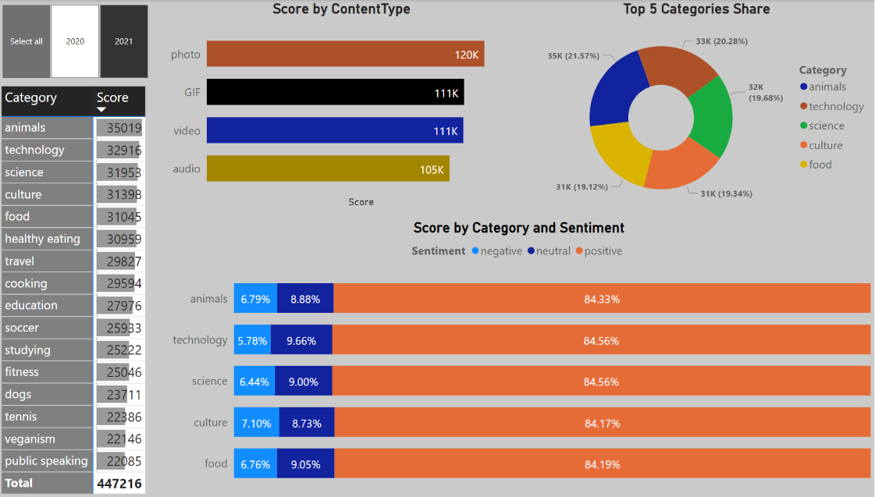
Analysis & Insights
Notes:
Now coming to year 2021, the first significant difference is the top 5 categories. Compared to 2020 and all-time, the contents related to culture outnumbered the healthy eating related content in 2021. The culture has been the 4th most reacted content in 2021, whereas healthy eating related content is not present in the top 5 popular contents. This trend implies that there is a possibility that in coming time, culture related posts may increase.

Slide 10
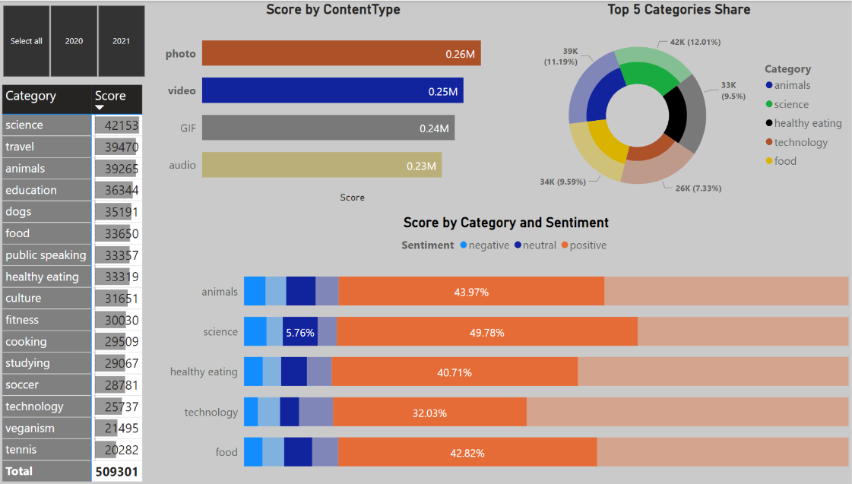
Analysis & Insights
Notes:
Concerning the size of data to tackle, photos and videos occupy more than 50% of the content types. Interestingly, content related to science and travel are mostly posted with photos and videos.

Slide 11

Summary
Notes:
To conclude the presentation, I would say that the task has been performed successfully. Summarizing the insights, I would say that all-time favourite categories are animals ad science. However, the rise in the posts related to culture should not be ignored. Thank you for your kind attendance and patience.

